Slide 1
ECON3113 Microeconomic Theory I
Online Assignment #1 Solution
Tutorial - ECON 3113 Microeconomic Theory I

Slide 2
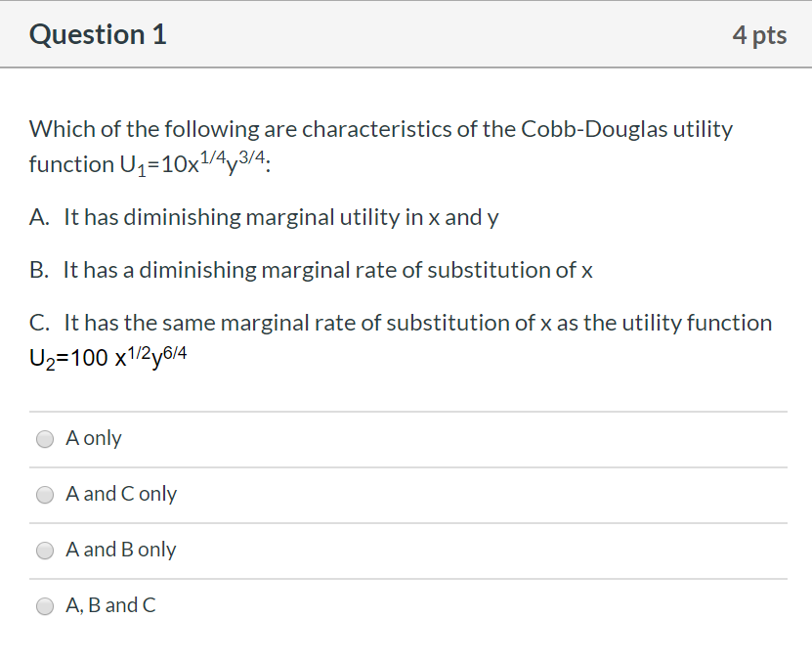
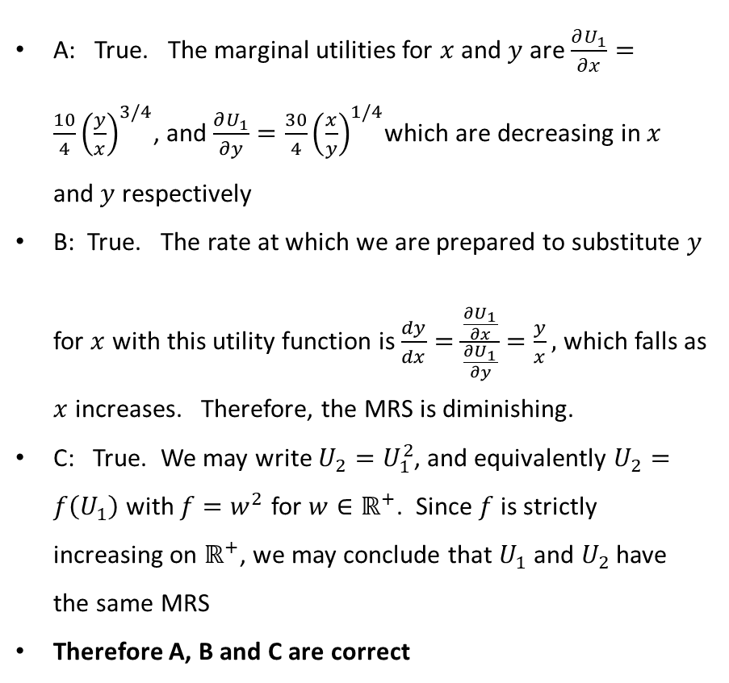
Online assignment #1
A: True. The marginal utilities for $x$ and $y$ are $\frac{∂U_{1}}{∂x}=\frac{10}{4}{\left(\frac{y}{x}\right)}^{3/4}$, and $\frac{∂U_{1}}{∂y}=\frac{30}{4}{\left(\frac{x}{y}\right)}^{1/4}$which are decreasing in $x$ and $y$ respectively
B: True. The rate at which we are prepared to substitute $y$ for $x$ with this utility function is $\frac{dy}{dx}=\frac{\frac{∂U_{1}}{∂x}}{\frac{∂U_{1}}{∂y}}=\frac{y}{x},$ which falls as $x$ increases. Therefore, the MRS is diminishing.
C: True. We may write $U_{2}=U_{1}^{2}$, and equivalently $U_{2}=f\left(U_{1}\right)$ with $f=w^{2}$ for $w∈ℝ^{+}$. Since $f$ is strictly increasing on $ℝ^{+}$, we may conclude that $U_{1}$ and $U_{2}$ have the same MRS
Therefore A, B and C are correct
Tutorial - ECON 3113 Microeconomic Theory I

Slide 3
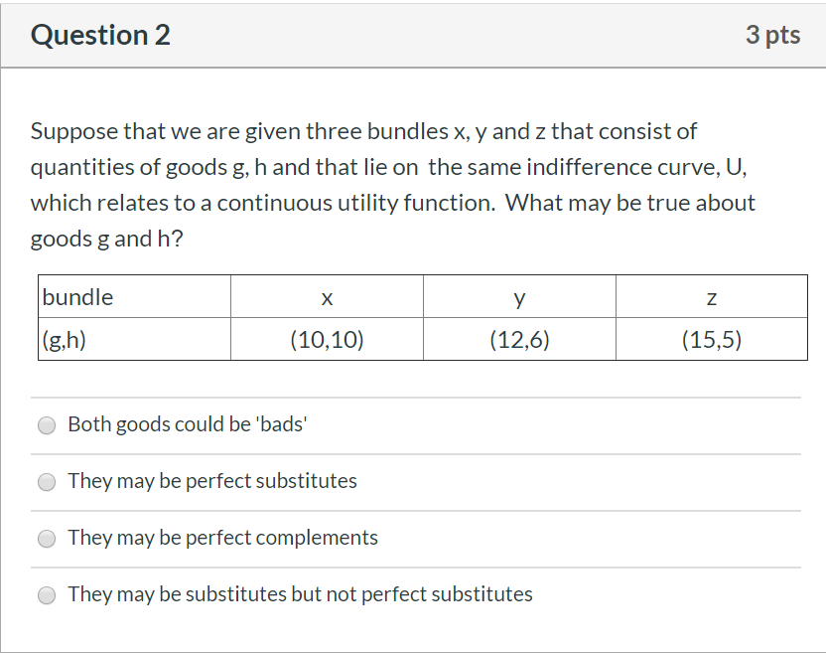
Online assignment #1
Both goods could be ‘bads’
The assumption here was that the indifference curve would be for positive utility. However, without stating it, there is no reason that both good couldn’t be ‘bads’; points were awarded accordingly
They may be perfect substitutes
Indifference curves for perfect substitutes are linear; in this case, x, y and z do not lie on a single line segment, therefore the goods cannot be perfect substitutes
They may be perfect complements
Indifference curves in this case have a corner point, which we do not have in this case (see lecture notes)
They may be substitutes but not perfect substitutes
This is true: there is no reason to rule out that the goods may be substitutes
Tutorial - ECON 3113 Microeconomic Theory I

Slide 4
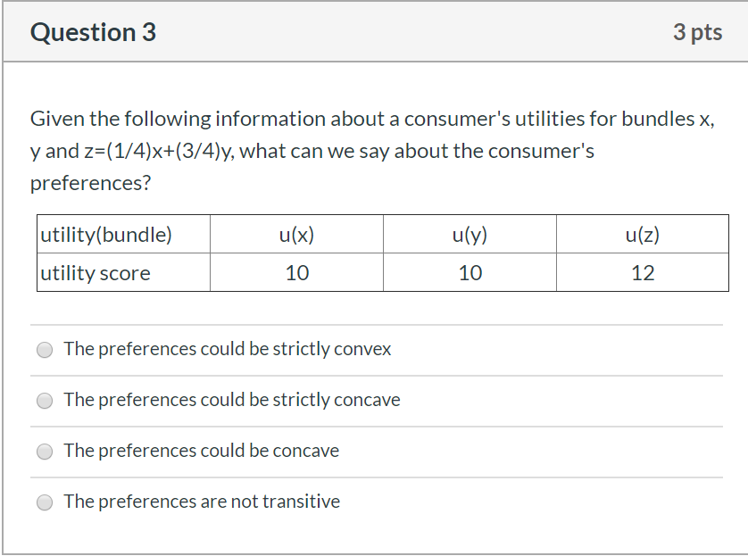
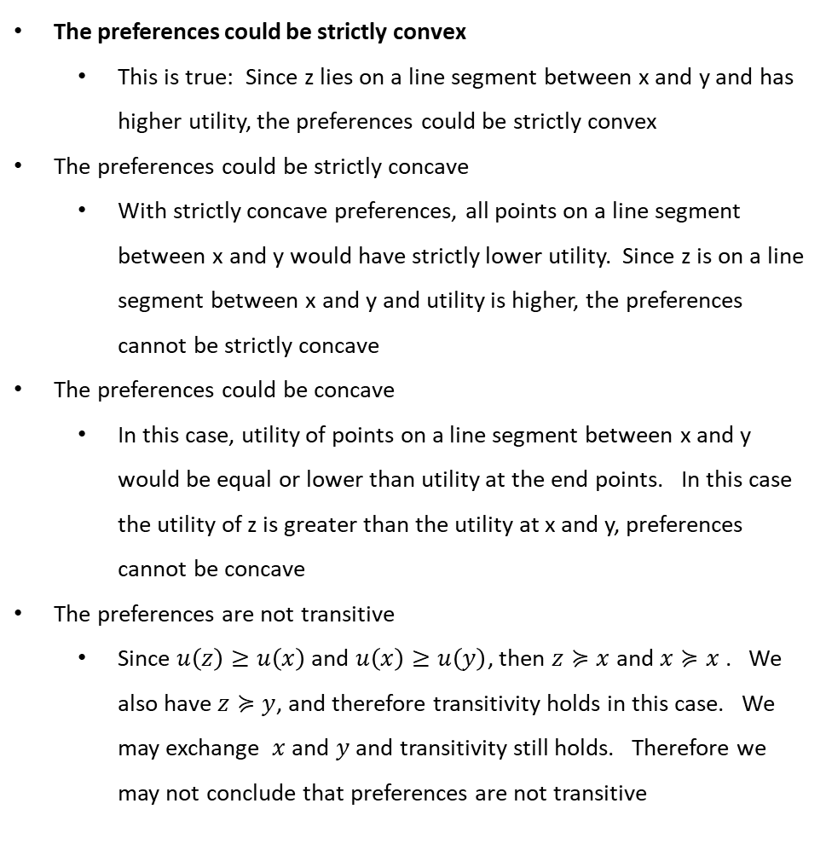
Online assignment #1
The preferences could be strictly convex
This is true: Since z lies on a line segment between x and y and has higher utility, the preferences could be strictly convex
The preferences could be strictly concave
With strictly concave preferences, all points on a line segment between x and y would have strictly lower utility. Since z is on a line segment between x and y and utility is higher, the preferences cannot be strictly concave
The preferences could be concave
In this case, utility of points on a line segment between x and y would be equal or lower than utility at the end points. In this case the utility of z is greater than the utility at x and y, preferences cannot be concave
The preferences are not transitive
Since $u\left(z\right)≥u\left(x\right)$ and $u\left(x\right)≥u\left(y\right)$, then $z≽x$ and $x≽x$ . We also have $z≽y$, and therefore transitivity holds in this case. We may exchange $x$ and $y$ and transitivity still holds. Therefore we may not conclude that preferences are not transitive
Tutorial - ECON 3113 Microeconomic Theory I

Slide 5
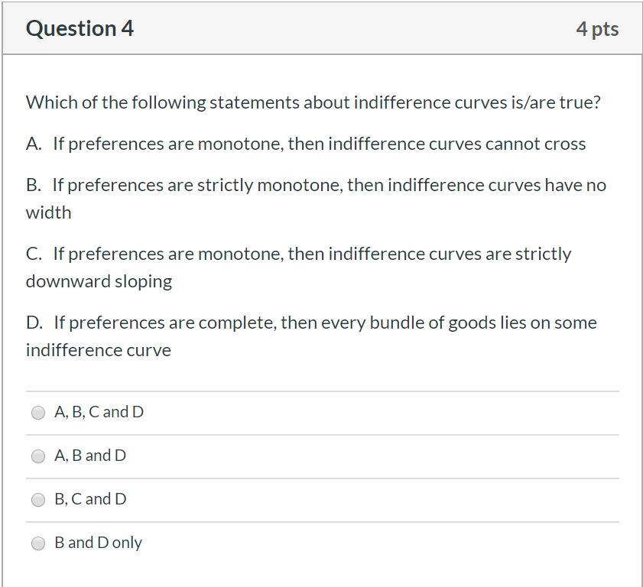
Online assignment #1
A: If preferences are monotone, then indifference curves cannot cross
Indifference curves cannot cross by definition, regardless of whether or not preferences are monotone. Therefore, this option is incorrect in that there is not causality between monotonicity and non-crossing indifference curves. However, indifference curves with monotone preferences will not cross. Because of this ambiguity, points were awarded for answers that also considered this to be true.
B: If preferences are strictly monotone then indifference curves have no width
This is true, as in the lecture notes
C: If preferences are monotone, then indifference curves are strictly downward sloping
Preferences need to be strictly monotone for this to be the case, therefore this option is incorrect
D: If preferences are complete, then every bundle of goods lies on some indifference curve
This is true, as in the lecture notes
Therefore, A, B and D are correct, and answers A, B and D, and B and D only were graded correct
Tutorial - ECON 3113 Microeconomic Theory I

Slide 6
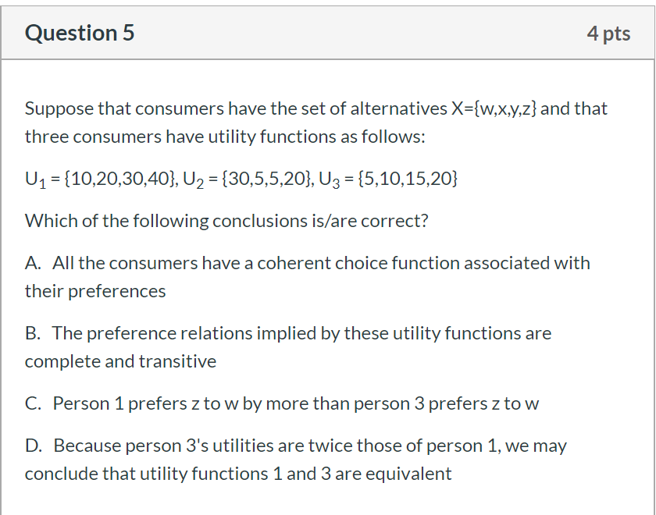

Online assignment #1
A: All the consumers have a coherent choice function associated with there preferences
This is true: the utility function implies a coherent choice function
B: The preference relations implied by these utility functions are complete and transitive
This is true: this is an implication of the utility functions
C: Person 1 prefers z to w by more than person 3 prefers z to w
False: utility function in this theory are ordinal, rather than cardinal, and so we cannot make this comparison
D: Because person 3’s utilities are twice those of person 1, we may conclude that utility functions 1 and 3 are equivalent
First, those answers that considered that the question should have said ‘half’ rather than ‘twice’, and that mathematically the utility functions are equivalent were graded as correct.
Second, those answers that answered the question as written and concluded that person 3’s utilities are not twice person 1’s utilities were also graded as correct.
Therefore, A and B only, and A, B and D were graded as correct
Tutorial - ECON 3113 Microeconomic Theory I

Slide 7
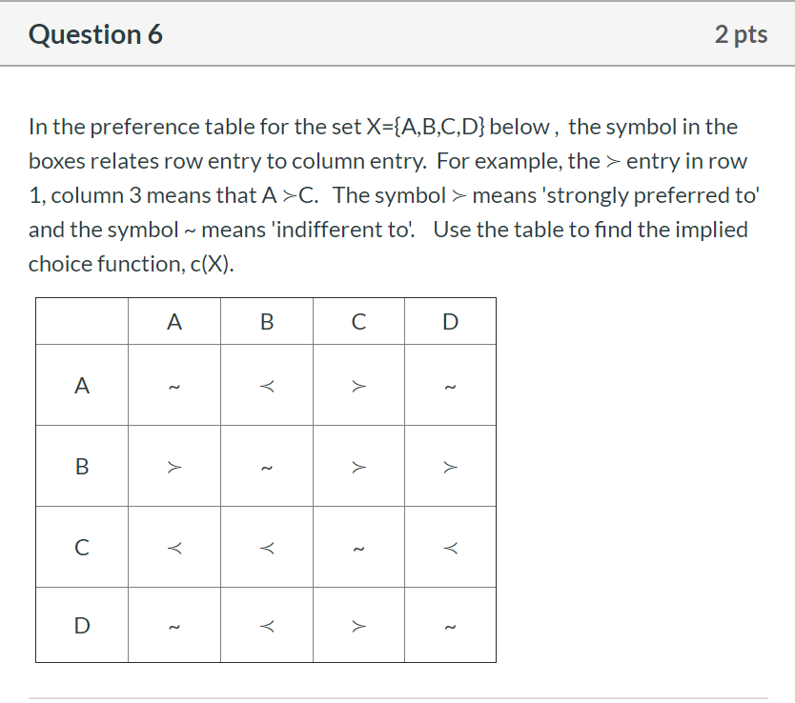

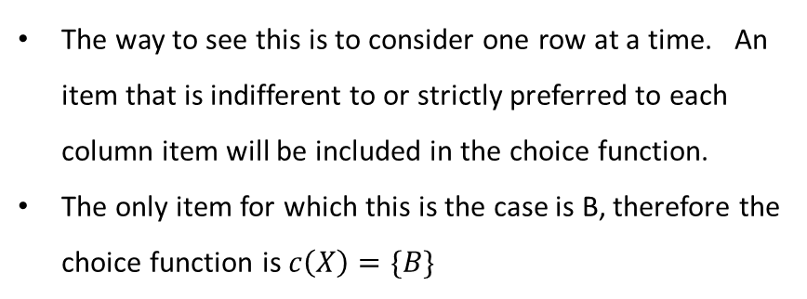
Online assignment #1
The way to see this is to consider one row at a time. An item that is indifferent to or strictly preferred to each column item will be included in the choice function.
The only item for which this is the case is B, therefore the choice function is $c\left(X\right)=\{B\}$
Tutorial - ECON 3113 Microeconomic Theory I

